Slide 1


Slide 2
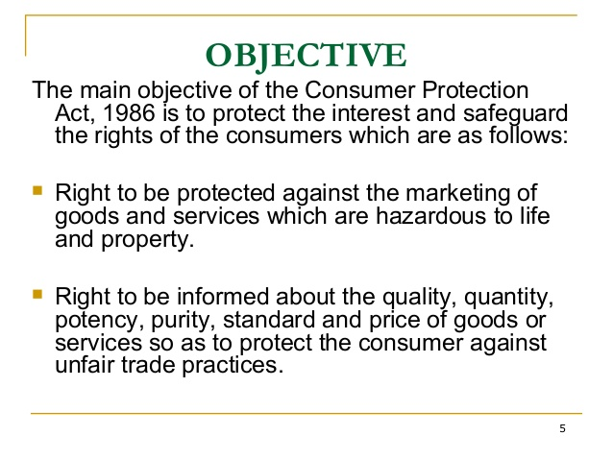

Slide 3


Slide 4
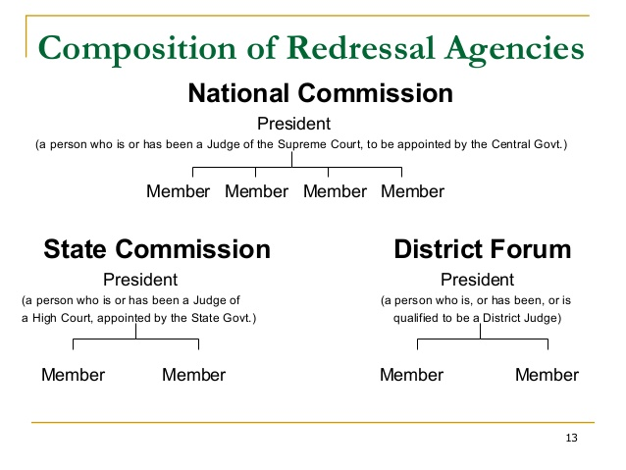

Slide 5
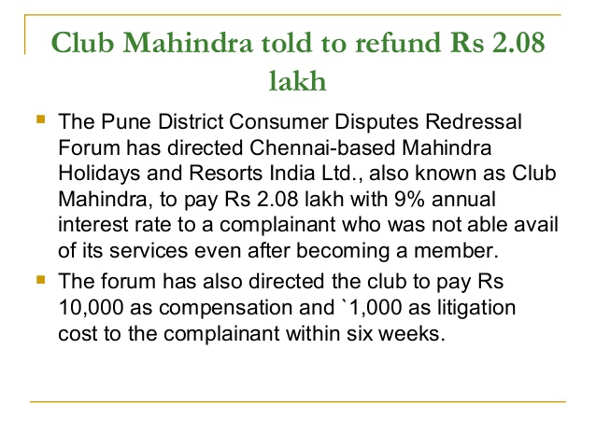
CASE STUDY

Slide 6
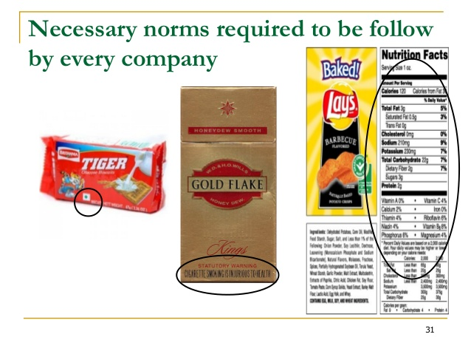

Slide 7
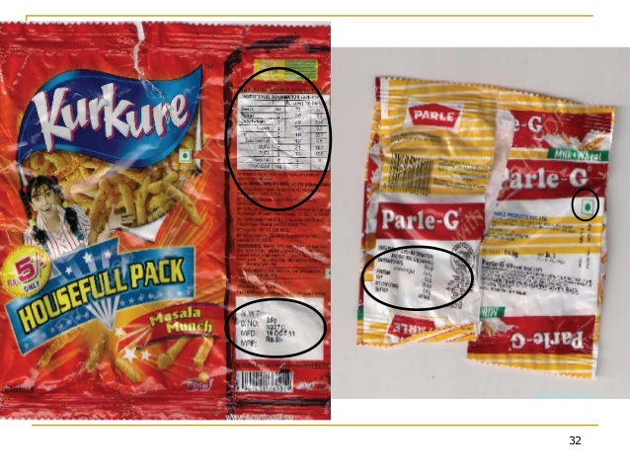
NECESSARY NORMS TO BE FOLLOWED BY EVERY COMPANY

Slide 8


Slide 9


Slide 10


Slide 11
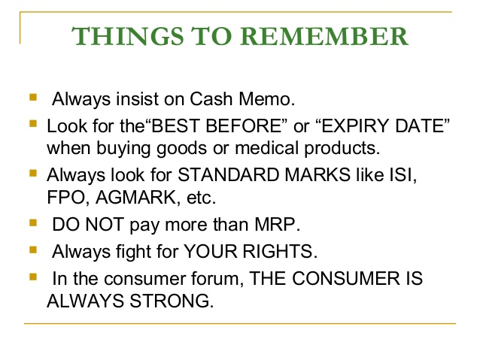

Slide 12
THANK YOU
BY MS. RUNA GHOSH

